Slide 1
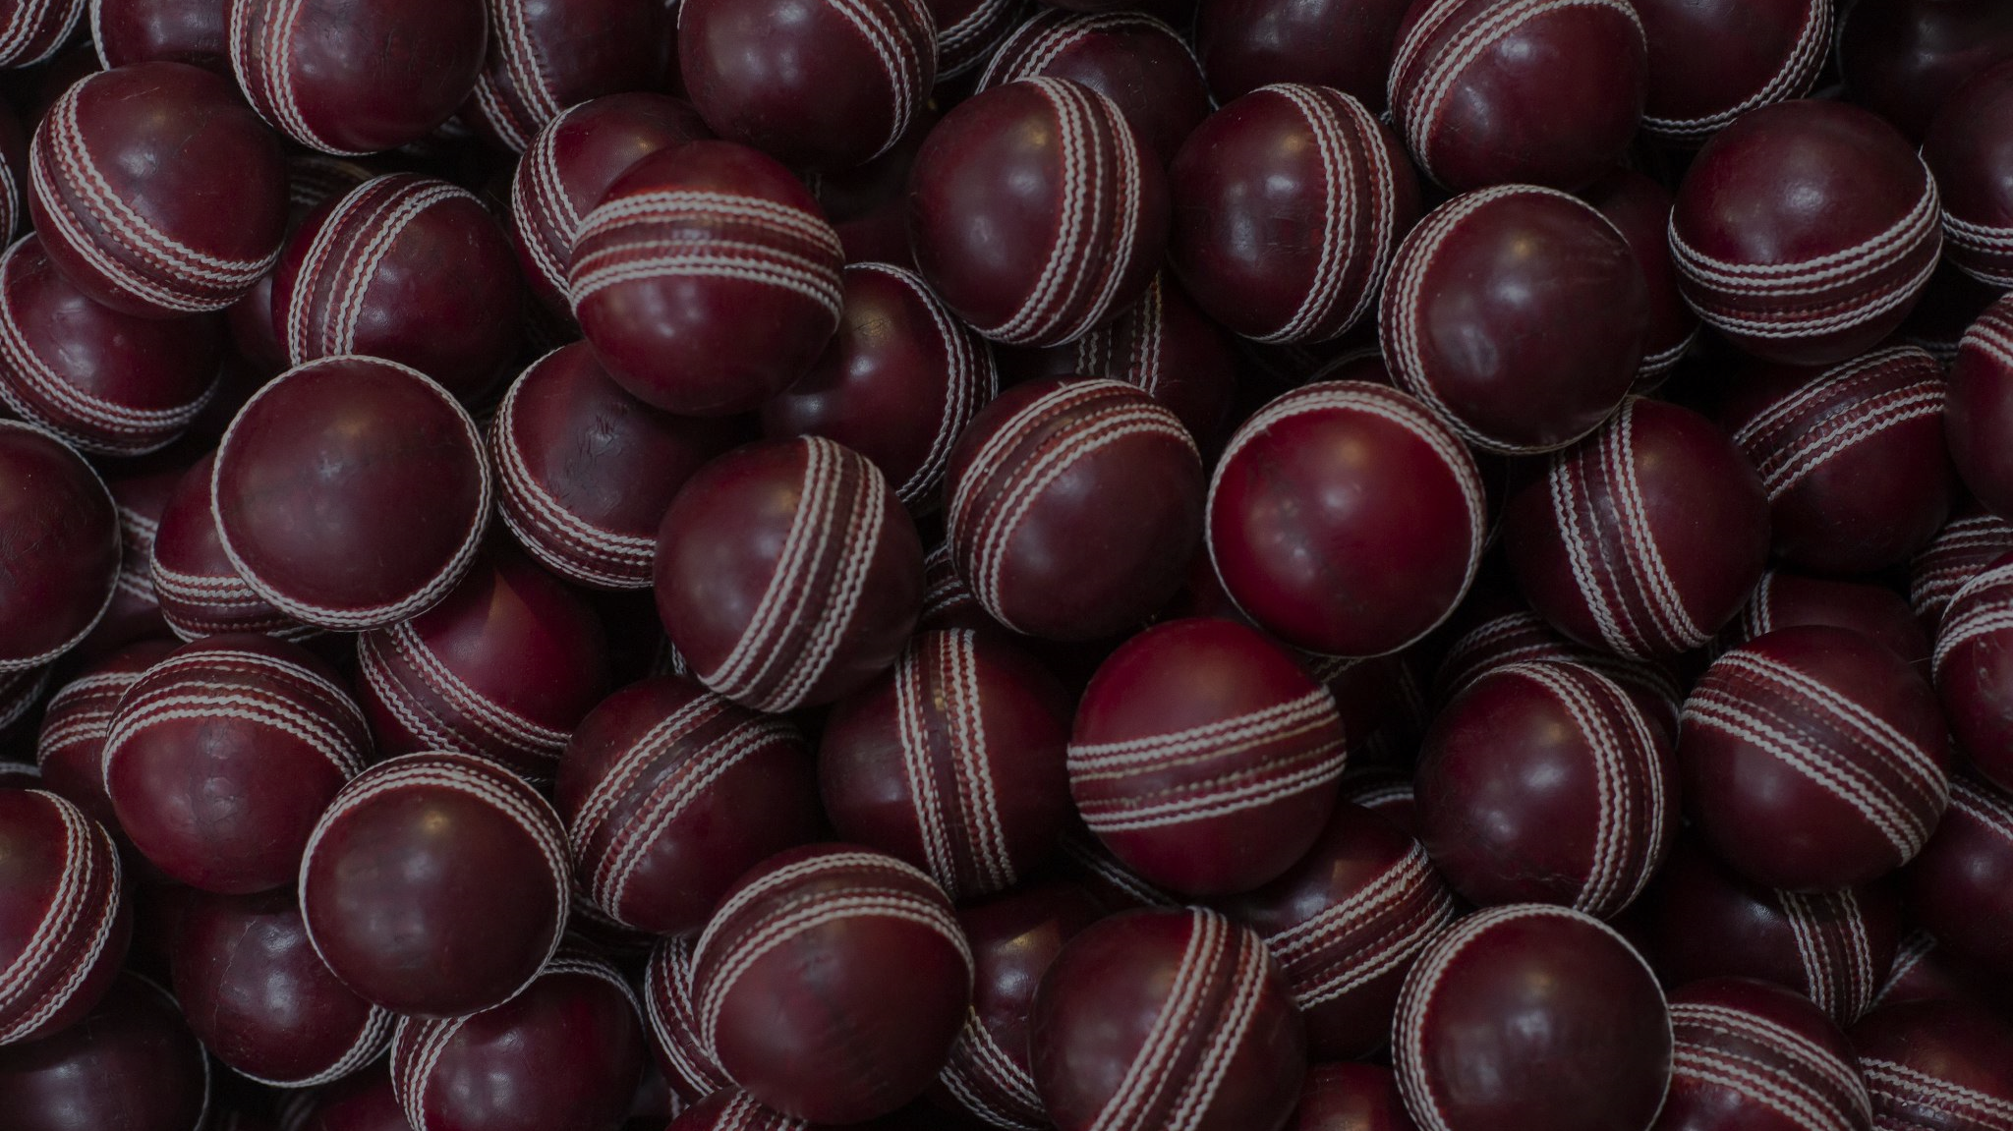

CRICEX Cricket Match Highlight Extractor
Presented by :-
Asfahan Shah
Pranjal Bhardwaj
Saksham Khandelwal
Atindra Shekhar
Sadhil Chhabra

Slide 2

This is Sarthak of age 28. He is working as a highlight editor in a cricketing organization

Slide 3

Nowadays people are very busy and there are various cricket formats of varying lengths

Slide 4
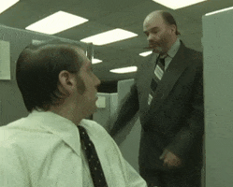
Sarthak's boss constantly asks him to produce the highlights faster.

Slide 5

Sarthak not able to cope-up with the demand

Slide 6

This is where Cricex comes to rescue

Slide 7
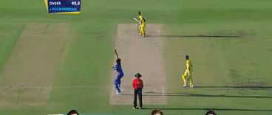
Cricex filters all the non relevant stuff thus saving the time of the editor

Slide 8


